Slide 1

MACHINE LEARNING

Slide 2
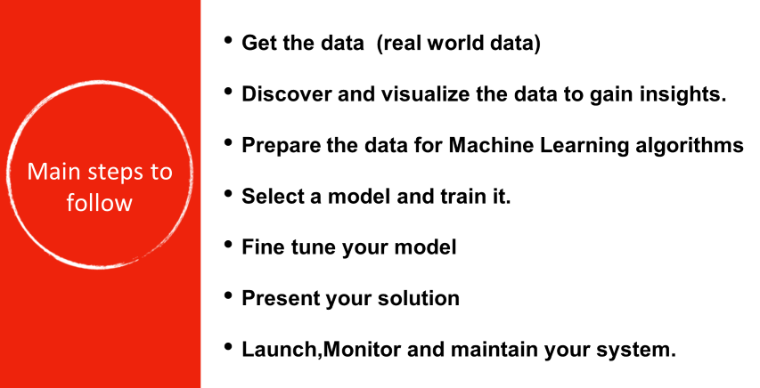

Slide 3
Supervised Machine Learning
Price of house ?
Price of cars ?
How many seconds user is going to watch a video?
REGRESSION
Fraud, Not-fraud
Male or Female
Dog or Cat
Spam , Not spam
CLASSIFICATION
Predict Continuous values
Predict Discrete values

Slide 4
CLASSIFICATION AND REGRESSION
TRANSACTION AMOUNT | CLASS
2,000 | NO FRAUD
40,000 | FRAUD
20,000 | FRAUD
10,000 | NO FRAUD
8,000 | NO FRAUD
EXPERIENCE | SALARY
2 | 35,000
3 | 38,000
4 | 42,000
5 | 45,000
7 | 48,000
DEPENDENT
VARIABLE
INDEPENDENT VARIABLE
INDEPENDENT VARIABLE
DEPENDENT
VARIABLE
CONTINUOUS DEPENDENT VARIABLE
CATEGORICAL DEPENDENT VARIABLE
REGRESSION PROBLEM
CLASSIFICATION PROBLEM

Slide 5
MACHINE LEARNING PROCESS
PROBLEM
STATEMENT
Imputing missing values.
Scaling and normalising features.
Feature engineering
Transforming categorical features into numeric
Supervised models.
Unsupervised models.
Reinforcement models.
Confusion matrix.
Accuracy
Precision & Recall
Train Test validation
Checking overfitting and underfitting
PREPROCESSING
MODELING
MODEL EVALUATION
DATA
Divide data into training and testing
Apply model as per problem statement.
Evaluate model performance

Slide 6
APPLICATIONS OF MACHINE LEARNING
Virtual personal assistants.
Recommendation engines
Fraud detection
Self driving cars
Stock movement prediction
Stock movement prediction
Speech recognition
Customer sentiment analysis

Slide 7


Slide 8
“TORTURE THE DATA. AND IT WILL CONFESS TO ANYTHING”

Slide 9
Selecting a Model
Y = f(x) + e, where ‘f’ is the target function and ‘e’ is a random error term
Just like ‘Target function’ ,some other functions which are frequently tracked are
Cost Function (Error Function) It helps to measure the extent to which the model is going wrong in estimating the relationship between X and Y.
Loss Function is almost synonymous to Cost Function-the only difference being loss function is usually a function defined on a data point.

Slide 10

Regression
Function: a mathematical relationship enabling us to predict what values of one variable (Y) correspond to given values of another variable (X).
Y: is referred to as the dependent variable, the response variable or the predicted variable.
X: is referred to as the independent variable, the explanatory variable or the predictor variable.

Slide 11
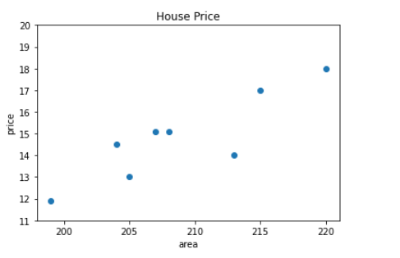
LINEAR REGRESSION
AREA (sqft.) | PRICE(Lakh)
199 | 11.9
204 | 14.5
205 | 13
207 | 15.4
208 | 15.1
215 | 17
220 | 18
213 | 15
210 | ?

Slide 12
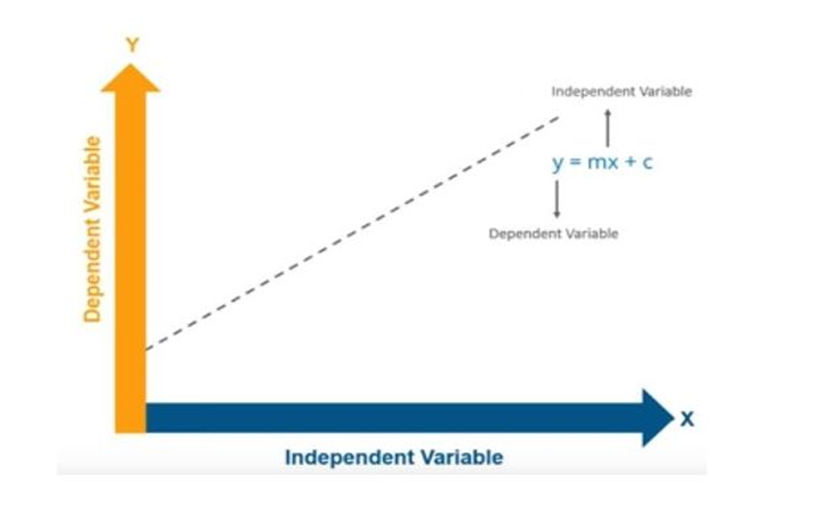
Representation

Slide 13

Steps to do:
Examine the scatterplot of the data.
i. Does the relationship look linear?
ii. Are there points in locations they shouldn’t be?
iii. Do we need a transformation?
Assuming a linear function looks appropriate, estimate the regression parameters.
i. How do we do this? (Method of Least Squares)
If there is a significant linear relationship, estimate the response, Y, for the given values of X, and compute the residuals

Slide 14
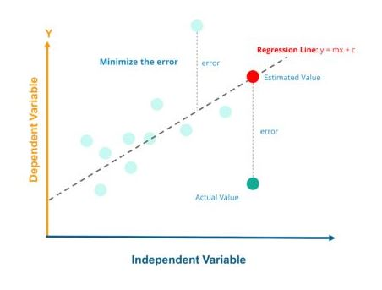
A typical Linear Regression model can be represented in the form : y = b1x + b0 where b1 is slope and b0 is the intercept.

Slide 15
Regression Analysis
Thus we have the regression formula as :
Y = b1X +b0 + error(e)
Initially we calculate the value for slope and predict the values of Y for any given X values we have.
Slope(b1) = ∑(x - (mean of x)(y - (mean of y))/∑(x - (mean of x))^2
Thus we calculate the b0 value and find out the “Line of Regression”.

Slide 16
Final Step:
Next our job is to reduce the distance between the actual value and the predicted value or in other words reduce the error between the actual and predicted value. Thus the line with least error will be the “Best Fit Line”.
In order to check it out we calculate the “Coefficient of Determination”[R-squared value].
R-squared value = 1 - ∑(y predicted - mean of y )^2/ ∑(y - mean of y)^2.
R^2 = 1 – SS(res) Residual sum of squares/ SS(tot) Total Sum of Squares
Thus our ultimate aim is to reduce the error i.e., distance between the actual and predicted values.

Slide 17
Draw a best fit line which can better estimate house prices.

Slide 18
We can draw so many lines how to decide the best one ?

Slide 19
A line which is at minimum distance from each point.

Slide 20
EQUATION OF A LINE
y = mx + c
y-axis
y = mx + c
m = slope
x = variable
c = intercept
x-axis

Slide 21
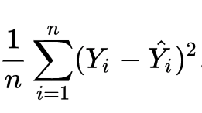
error

